Slide 1

Notes:
Cover Slide

Slide 2


RATIOS, PROPORTIONS AND VARIATIONS
Notes:
This is the template for slides with an image and a bullet list

Slide 3
RATIOS:
A ratio is a relationship between two numbers indicating how many times the first number contains the second.
For example, if a bowl of fruit contains eight oranges and six lemons, then the ratio of oranges to lemons is eight to six (that is, 8∶6, which is equivalent to the ratio 4∶3).

Slide 4
PROPORTIONS:
A proportion is simply a statement that two ratios are equal. It can be written in two ways: as two equal fractions a/b = c/d; or using a colon, a:b = c:d. ...
In problems involving proportions, we can use cross products to test whether two ratios are equal and form a proportion.
A proportion is an equation with a ratio on each side. It is a statement that two ratios are equal. 3/4 = 6/8 is an example of a proportion.

Slide 5
VARIATIONS:
Variation deals with how one quantity changes with respect to one or more other quantities.
Two quantities are said to vary with each other, if there exists a relationship between them such that a change is ‘A’ entails a change in ‘B’ and vice-versa.
There are two types of variation: direct variation and inverse variation.
Notes:
Webinar Cover

Slide 6
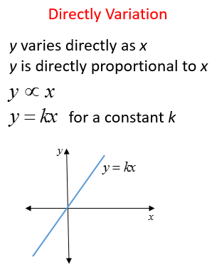
DIRECT VARIATIONS:
If Quantity 1 varies directly with Quantity 2; i.e. Quantity 2 increases if Quantity 1 increases and Quantity 2 decreases if Quantity 1 decreases;
then they are said to be in direct variation. For example, if Time is constant, the Speed will be directly proportional to the distance. That is, if the Speed is more, then the distance covered will also be more, and vice-versa Speed α Distance
.
Notes:
Webinar Cover

Slide 7
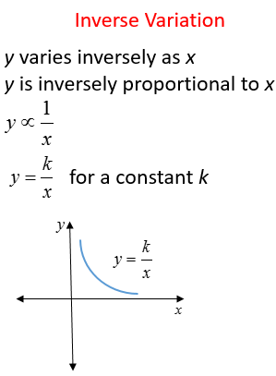
INVERSE VARIATIONS:
If Quantity 1 varies inversely with Quantity 2, then they are said to be in inverse variation. For example, Speed varies inversely with time; that is if the Speed is more, then the time taken to cover a constant distance will be less. This means that when speed is minimum, then time is maximum; and when speed is maximum, then time is minimum.
.
Notes:
Webinar Cover

Slide 8
FORMULA:
If u/v = x/y, then uy = vx
If u/v = x/y, then u/x = v/y
If u/v = x/y, then v/u = y/x
If u/v = x/y, then (u+v)/v = (x+y)/y
If u/v = x/y, then (u-v)/v = (x-y)/y
If u/v = x/y, then (u+v)/ (u-v) = (x+y)/(x-y), which is known as componendo -Dividendo Rule
If u/v = v/x, then u/x = u²/v²
If u/v = x/y, then u = x and v =y
If a/(b+c) = b/(c+a) = c/(a+b) and a+b+ c ≠0, then a =b = c

Slide 9
CONCEPTS:
Suppose we have two quantities or two numbers or two entities and
we have to find the ratio of these two, then the formula for ratio is defined as;
a: b ⇒ a/b
where a and b could be any two quantities.
Here, “a” is called the first term or antecedent, and “b” is called the second term
or consequent.
Now, let us assume that, in proportion, the two ratios are a:b & c:d.
The two terms ‘b’ and ‘c’ are called ‘means or mean term,’
whereas the terms ‘a’ and ‘d’ are known as ‘extremes or extreme terms.’
a/b = c/d or a : b :: c : d

Slide 10
Question: 01
For any two numbers m, n ; (m+n) : (m-n) : mn = 7: 1: 60 . Find the value of 1/m : 1/n
3:4
4:3
5:4
4:5
Answer: A
Notes:
This is the template for slides with only a bullet list

Slide 11
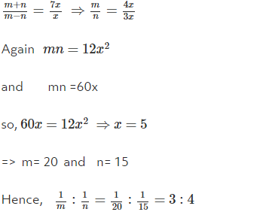
Solution:
Notes:
This is the template for slides with only a bullet list

Slide 12
Question: 02
Vinod have 20 rupees. He bought 1, 2, 5 rupee stamps. They are different in numbers by the reason of no change, the shop keeper gives 3 one rupee stamps. So how many stamps Vinod have?
10
18
12
15
Answer: A
Notes:
This is the template for slides with only a bullet list

Slide 13
Solution:
Given total rupees = 20 Rs No. of one rupee stamps = 3 Now, remaining money = Rs. 17 With that he buys only 2 and 5 rupee stamps Let number of Rs. 5 stamps = K Let number of Rs. 2 stamps = L 5K + 2L = 17 K = 3, L = 1 (possible) L = 6, K = 1 (possible) => But given that they are different in number so, K is not equal to 3 one rupee stamps = 3,2 two stamps = 6,5 rupee stamps = 1 Total number of stamps = 10.
Notes:
This is the template for slides with only a bullet list

Slide 14
Question: 03
What is the ratio whose terms differ by 40 and the measure of which is 2/7?
16:56
14:56
15:56
16:72
Answer: A
Notes:
This is the template for slides with only a bullet list

Slide 15

Solution:
Let the ratio be x : (x + 40), then ,
7x = 2x + 80
x = 16
Required ratio = 16 : 56
Notes:
This is the template for slides with only a bullet list

Slide 16
Question: 04
A cubical block of metal weighs 6 pounds. How much will another cube of the same metal weigh if its sides are twice as long?
12
36
48
72
Answer: C
Notes:
This is the template for slides with only a bullet list

Slide 17
Solution:
If you double the sides of a cube, the ratio of the surface areas of the old and new cubes will be 1: 4. The ratio of the volumes of the old and new cubes will be 1: 8.
Weight is proportional to volume. So, If the first weighs 6 pounds, the second weighs 6x8 pounds =48.
Notes:
This is the template for slides with only a bullet list

Slide 18
Question: 05
A fort has provisions for 60 days. If after 15 days 500 men strengthen them and the food lasts 40 days longer, how many men are there in the fort?
3500
4000
6000
None of these
Answer: B
Notes:
This is the template for slides with only a bullet list

Slide 19
Solution:
Let there be 'x' men in the beginning so that after 15 days the food for them is left for 45 days.After adding 500 men the food lasts for only 40 days. Now (x+500) men can have the same food for 40 days. Therefore by equating the amount of food we get, 45 * x = (x + 500) * 40 45x = (x+500) * 40 5x = 20,000 x = 4,000 Therefore there are 4,000 men in the fort.
Notes:
This is the template for slides with only a bullet list

Slide 20
Question: 06
In a map of scale 1:20,000, what will be the length of the border between Telangana and Andhra Pradesh, if the actual border in 2,250 kms?
11.25 cms
112.50 cms
1125 cms
11250 cms
Answer: D

Slide 21
Solution:
The length on the map = 2,250 * 1,00,000 cms/20,000 = 11,250 cms...

Slide 22
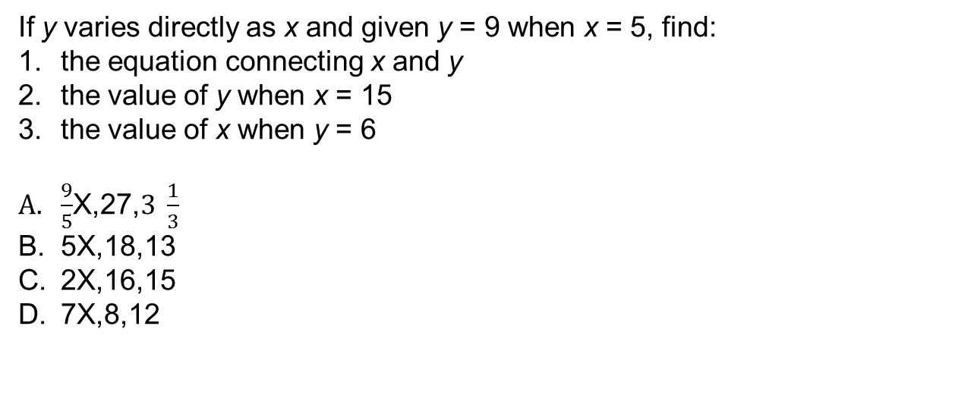
Question: 07
If y varies directly as x and given y = 9 when x = 5, find:
the equation connecting x and y
the value of y when x = 15
the value of x when y = 6
$\frac{9}{5}$X,27,$3 \frac{1}{3}$
5X,18,13
2X,16,15
7X,8,12
Answer: A

Slide 23
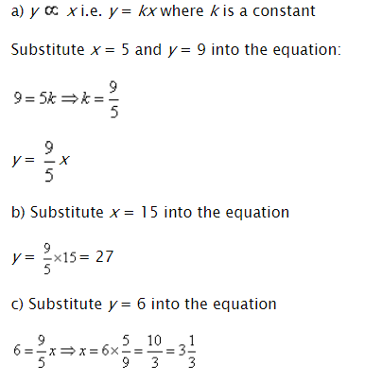
Solution:

Slide 24
Question: 08
The cost of a taxi fare (C) varies directly as the distance (D) travelled. When the distance is 60 km, the cost is $35. Find the cost when the distance is 95 km.
$54.32
$55.42
$56.62
$58.72
Answer: B

Slide 25

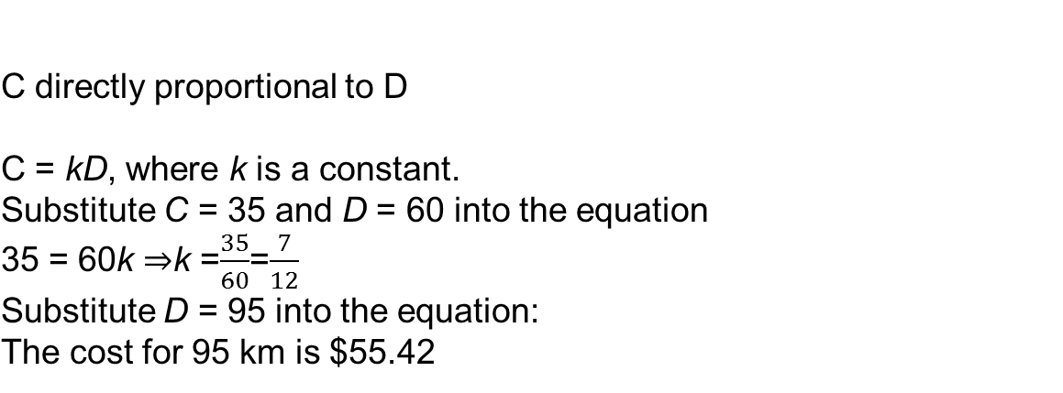
Solution:
C directly proportional to D
C = kD, where k is a constant. Substitute C = 35 and D = 60 into the equation 35 = 60k ⇒k =$\frac{35}{60}$=$\frac{7}{12}$ Substitute D = 95 into the equation: The cost for 95 km is $55.42

Slide 26
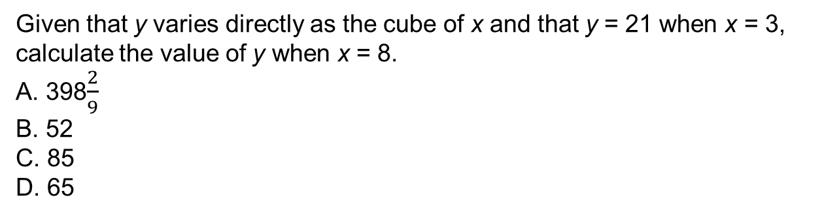
Question: 09
Given that y varies directly as the cube of x and that y = 21 when x = 3, calculate the value of y when x = 8.
A. 398$\frac{2}{9}$
B. 52
C. 85
D. 65
Answer: A

Slide 27
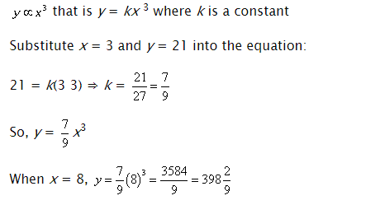
Solution:

Slide 28
Question: 10
A quantity y varies inversely with the cube of x. If y = 25 when x = 2, find y when x is 6.
23/25
25/27
28/26
27/25
Answer: B

Slide 29
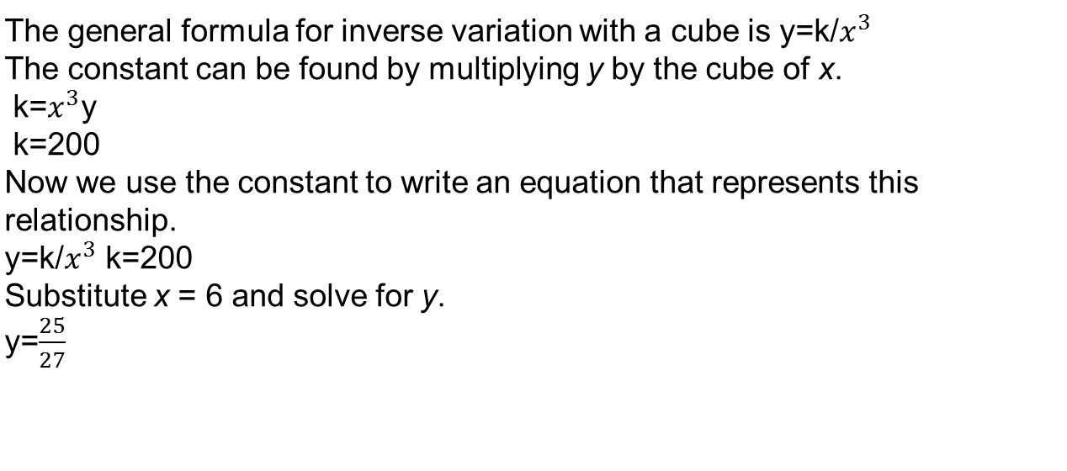
Solution:
The general formula for inverse variation with a cube is y=k/$x^{3}$ The constant can be found by multiplying y by the cube of x. k=$x^{3}$y k=200 Now we use the constant to write an equation that represents this relationship. y=k/$x^{3}$ k=200 Substitute x = 6 and solve for y. y=$\frac{25}{27}$

Slide 30
Question: 11
If 35 men can reap a field in 8 days; in how many days can 20 men reap the same field?
15days
16days
14days
10days
Answer: C

Slide 31
Solution:
35 men can reap the field in 8 days 1 man can reap the field in (35 × 8) days [less men, more days] 20 men can reap the field in (35 × 8)/20 days [more men, more days] = 14 days Hence, 20 men can reap the field in 14 days.

Slide 32
Question: 12
6 oxen or 8 cows can graze a field in 28 days. How long would 9 oxen and 2 cows take to graze the same field?
16days
15days
20days
14days
Answer: A

Slide 33
Solution:
6 oxen = 8 cows ⇒ 1 ox = 8/6 cows ⇒ 9 oxen ≡ (8/6 × 9) cows = 12 cows ⇒ (9 oxen + 2 cows) ≡ (12 cows + 2 cows) = 14 cows Now, 8 cows can graze the field in 28 days 1 cow can graze the field in (28 × 8) days [less cows, more days] 14 cows can graze the field in (28 × 8)/14 days [more cows, less days] = 16 days Hence, 9 oxen and 2 cows can graze the field in 16 days.

Slide 34
Question: 13
6 typists working 5 hours a day can type the manuscript of a book in 16 days. How many days will 4 typists take to do the same job, each working 6 hours a day?
15days
30days
20days
40days
Answer: C

Slide 35
Solution:
6 typists working 5 hours a day can finish the job in 16 days 6 typists working 1 hour a day can finish it in (16 × 5) days [less hours per day, more days] 1 typist working 1 hour a day can finish it in (16 × 5 x 6)/6 days [less typists, more days] 1 typist working 6 hours a day can finish it in 6 days [more hours per day, less days] 4 typists working 6 hours a day can finish it (16 × 5 × 6)/(6 × 4) days = 20 days. Hence, 4 typists working 6 hours a day can finish the job in 20 days.

Slide 36
Question: 14
If 0.75: x :: 5:8, then x is equal to:
1.12
1.16
1.20
1.30
Answer: C

Slide 37
Solution:
(x * 5) = (0.75 *8) X=6/5 = 1.20

